Slide 1
Sentiment Analysis in Program Development
Linna Qian
(linna@ualberta.ca)
Department of Computing Science, University of Alberta

Slide 2
Introduction
The Problem:
Software development is susceptible to the emotive state of the workers
Bad days can affect the production of a company
Difficult for CEOs of big companies to gauge how their employees feel

Slide 3


Research Question
Is there a correlation between the success of Travis CI builds and the sentiment of commit messages pushed by the developers?¹
or

Slide 4
Background
Sentiment analysis
Computational process of determining whether the opinion expressed in a piece of text is positive, negative, or neutral ¹
Used to determine how people feel about a certain topic
Plays an important role in social media and other business initiatives
Used to improve customer service and relations

Slide 5
Project Objectives
Use sentiment analysis to extract the sentiment of developer pushed commit messages and compare it to the success of the build
Create a visual representation, in the form of a calendar, from the data extracted

Slide 6
Useful Definitions and Examples

Slide 7


GitHub
A website where programmers can store their projects for others to see, use, and develop¹
Travis CI
A continuous integration platform that automatically builds and tests code changes²

Slide 8
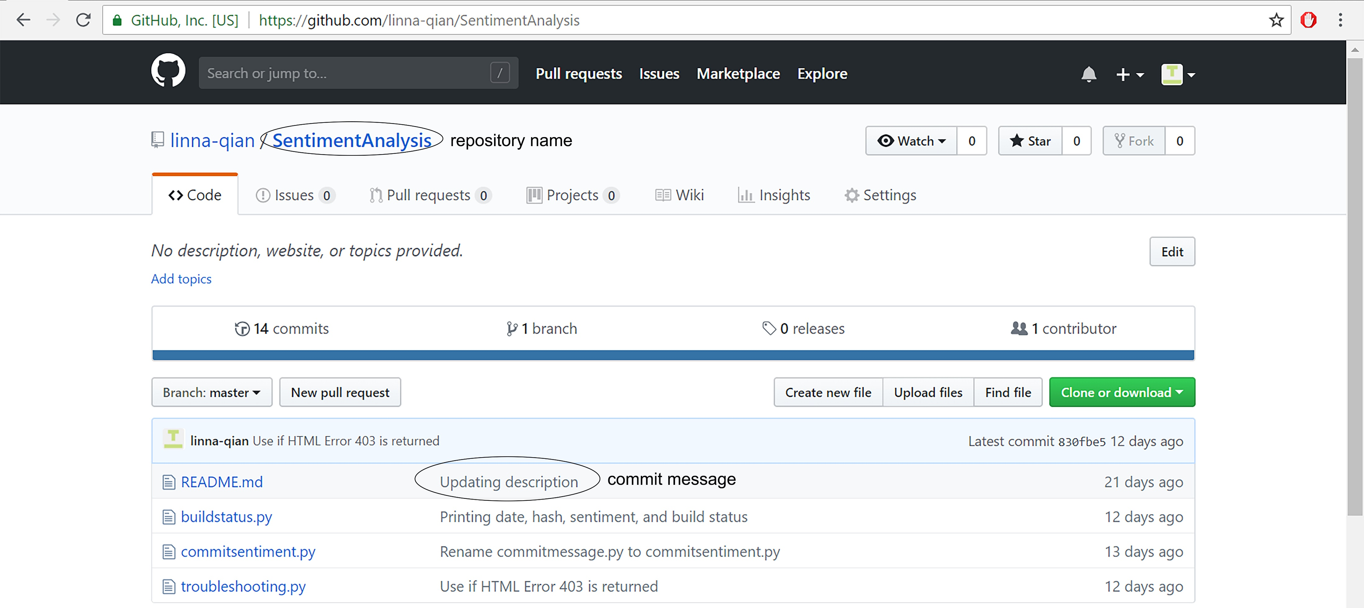
GitHub Repository and Commit Message
A GitHub repository is where the contents of a project are stored (project file)
Commit messages are messages that programmers attach to the work when they upload to their repository

Slide 9
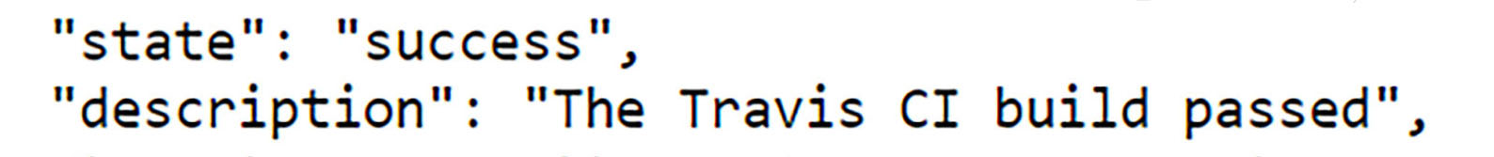
Continuous Integration
Merging smaller code changes more frequently rather than one big merge at the end¹
Travis CI Builds
The GitHub repository will be copied and tested in a virtual environment. If any part of the build fails, the build status returned will be either errored or failed¹

Slide 10
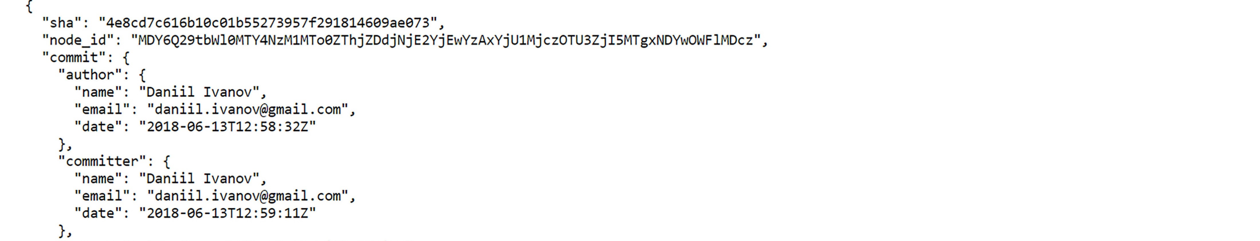
API (Application Programming Interface)
API is what allows remote servers and web applications to communicate. It receives requests from the user and sends a response back¹
JSON (JavaScript Object Notation)
JSON is a formatting used in data transfer between remote servers and web applications

Slide 11
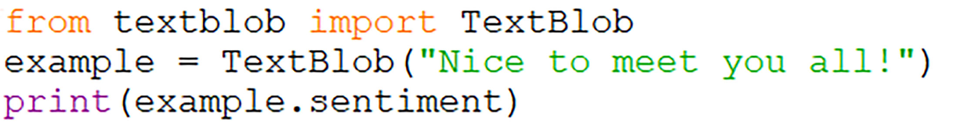
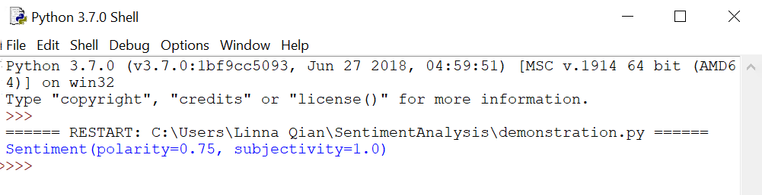
TextBlob and Sentiment Analysis
The sentiment of the commit messages will be extracted with a Python library called TextBlob. It will return the sentiment as a value between -1 and +1

Slide 12
The Research Process

Slide 13
Extract commit messages from GitHub repository
Extract sentiment of commit messages
Find a customizable calendar template
Extract build status of commit messages
Combine the data into a list
Convert to JSON format
Add data to calendar
Extract date of build status
Successful build = green
Failed build = red
Change the background color of calendar cells
Positive = 😃
Negative = 😭
Add emojis to represent sentiment
Analyze the calendar for any relationship
Extracting & Visualizing the Data

Slide 14
Conclusion

Slide 15
Acknowledgements
I would like to thank Dr. Sarah Nadi and Moein Owhadi-Kareshk for welcoming me into the SMR lab and giving me the opportunity to learn about sentiment analysis and program development.
I would also like to thank the Ross and Verna Tate foundation for providing me this opportunity through the High School Internship Program (HIP).

